Slide 1







BARANGAY PALAYAN
Solutions for Urban Agriculture
SDG 8: DECENT WORK AND ECONOMIC GROWTH

Slide 2
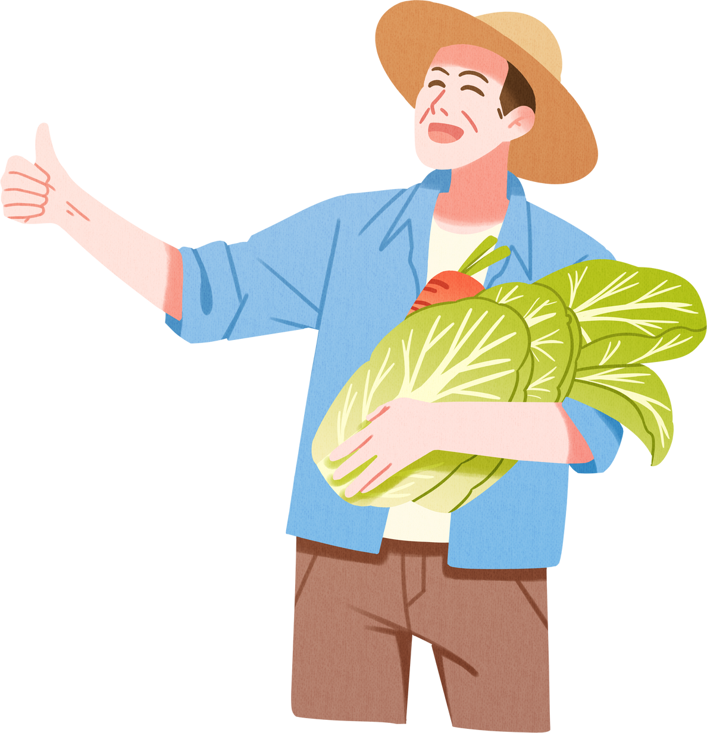
BARANGAY PALAYAN
Barangay Palayan’s economy revolves around rice farming and backyard livestock.
Population: 1,800 (majority aged 35+).
Average monthly income: ₱8,000 – ₱18,000.
Digital access: 50% smartphones, 40% mobile data users.

Slide 3

CURRENT ISSUES & PIN POINTS
Platform for bulk buyers of rice and produce
Cash-on-delivery preferred
Low tech literacy among older farmers

Slide 4



FARM2GO
FRESH FROM FARM REDY TO GO
Farm2GO (Farm to Go) connects farmers directly to buyers:
Simple Farmer Dashboard for uploading products.
Bulk Buyer Marketplace for direct transactions.
Payment Options: COD & Mobile Wallets (GCash, PayMaya).
Language-friendly interface (English & Filipino).

Slide 5


SUPPORTING SYSTEMS FOR FARMERS
Logistics & Delivery: J&T Express, LBC, Ninja Van, and local cooperatives.
Digital Literacy Training:
step-by-step tutorials.
Transparent delivery pricing to minimize hidden charges.

Slide 6


THANK YOU!
THANK YOU!
FARM2GO
“FRESH FROM TE FARM READY TO GO!”
-TORO FAM

